Slide 1
Systems Analysis and Design 11th Edition
Chapter 10 – System Architecture

Slide 2
Chapter Objectives
Provide a checklist of issues to consider when selecting a system architecture
Trace the evolution of system architecture from mainframes to current designs
Explain client/server architecture, including tiers, cost-benefit issues, and performance
Compare in-house ecommerce development with packaged solutions and service providers

Slide 3
Chapter Objectives (Cont.)
Discuss the impact of cloud computing and Web 2.0
Define network topology, including hierarchical, bus, ring, star, and mesh models
Describe wireless networking, including wireless standards, topologies, and trends
Describe the system design specification

Slide 4
Architecture Checklist
Issues that influence the architecture choice
Corporate organization and culture
Enterprise resource planning (ERP)
Initial and total cost of ownership (TCO)
Scalability
Web integration
Legacy system interface requirements
Processing options
Security issues
Corporate portals

Slide 5
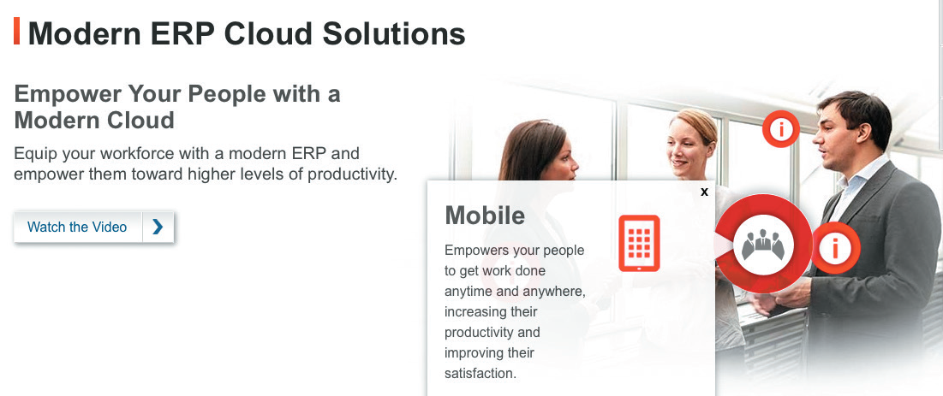
Architecture Checklist (Cont. 1)
Corporate Organization and Culture
A successful system performs well in a company’s organization and culture
Enterprise resource planning (ERP)
Objective – To establish a company-wide strategy for using IT that includes a specific architecture, standards for data, processing, network, and user interface design
FIGURE 10-1 Oracle offers ERP solutions as a cloud-based service.
Source: Oracle

Slide 6
Architecture Checklist (Cont. 2)
Companies are extending internal ERP systems to their suppliers and customers, using supply chain management (SCM)
Initial Cost and TCO
TCO includes tangible purchases, fees, and contracts called hard costs
TCO analysis answers questions about the validity, effectiveness, and new trends in systems planning
May affect the initial cost and TCO for a proposed system

Slide 7
Architecture Checklist (Cont. 3)
Scalability (Extensibility)
A system’s ability to expand, change, or downsize easily to meet the changing needs of a business enterprise
Web Integration
A web-centric architecture enables a company to integrate new applications into its ecommerce strategy
Legacy Systems
A new system might have to interface with legacy systems
Involves analysis of data formats and compatibility

Slide 8
Architecture Checklist (Cont. 4)
Processing Options
Systems can process data online or in batches
Security Issues
Analysts must consider security issues and how the company will address them
Corporate Portals
Provide access for customers, employees, suppliers, and the public
A well-designed portal can:
Integrate with various other systems
Provide a consistent look and feel across organizational divisions

Slide 9
System Architecture: Then and Now
Functions of a business information system
Manage applications that perform the processing logic
Handle data storage and access
Provide an interface that allows users to interact with the system
While planning system design:
Determine where the functions will be carried out
Identify the advantages and disadvantages of each design approach

Slide 10
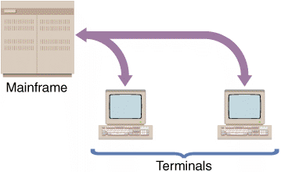
System Architecture: Then and Now (Cont. 1)
Mainframe Architecture
Server: A computer that supplies data, processing services or other support to one or more computers called clients
Earliest servers - Mainframe computers
All data input and output occurred at a central location
Advances in technology enabled installation of terminals at remote locations
FIGURE 10-3 In a centralized design, the remote user’s keystrokes are transmitted to the mainframe, which responds by sending screen output back to the user’s screen.

Slide 11
System Architecture: Then and Now (Cont. 2)
Impact of the Personal Computer
Individuals could work in stand-alone mode
The workstation performed all the functions of a server
Lesser IT assistance resulted in increased productivity in certain tasks
Absence of a central storage location raised concerns about data security, integrity, and consistency
Network Evolution
Local area network (LAN): Allows sharing of data and hardware resources
Wide area network (WAN): Spans long distances and can connect LANs that are continents apart

Slide 12
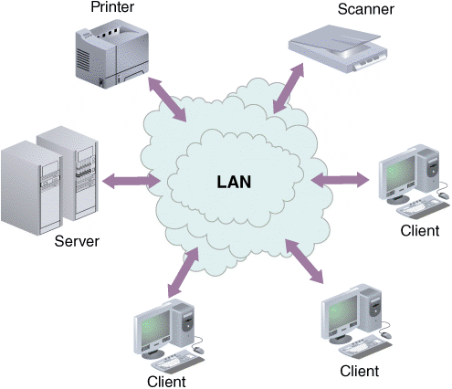
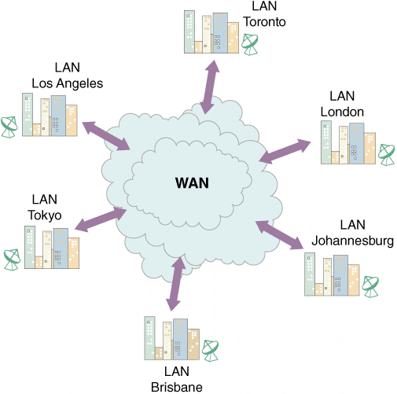
System Architecture: Then and Now (Cont. 3)
FIGURE 10-4 A LAN allows sharing of data and hardware, such as printers and scanners.
FIGURE 10-5 A WAN can connect many LANs and link users who are continents apart.

Slide 13
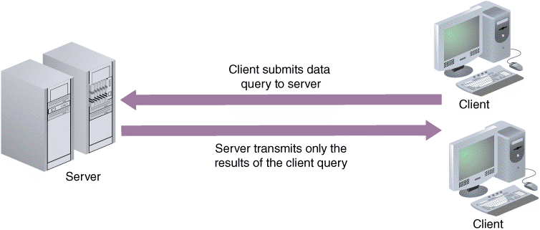
Client/Server Designs
Client/Server Architecture
Includes systems that divide processing between one or more networked clients and a central server
Client handles the entire user interface
Server stores data and provides data access and database management functions
FIGURE 10-6 In a client/server design, data is stored and usually processed on the server.

Slide 14
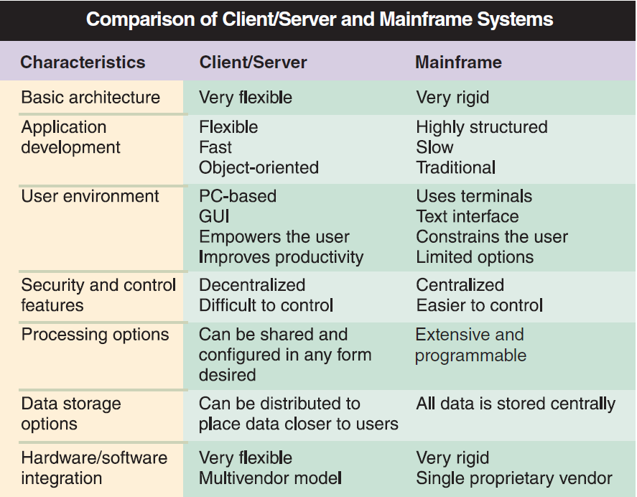
Client/Server Designs (Cont. 1)
FIGURE 10-7 Comparison of the characteristics of client/server and mainframe systems.

Slide 15
Client/Server Designs (Cont. 2)
The Client’s Role
Client/server relationship must specify how the processing will be divided between the client and the server
Fat client (thick client) design: Locates all or most of the application processing logic at the client
Thin client design: Locates all or most of the processing logic at the server
Provides better performance as the program code resides on the server

Slide 16
Client/Server Designs (Cont. 3)
Client/Server Tiers
Two-tier design
User interface resides on the client
Data resides on the server
Application logic can run either on the server or on the client, or be divided between the client and the server
Three-tier (n-tier) design
User interface runs on the client
Data is stored on the server
Has a middle layer between the client and server
Processes the client requests and translates them into data access commands
Considered an application server

Slide 17
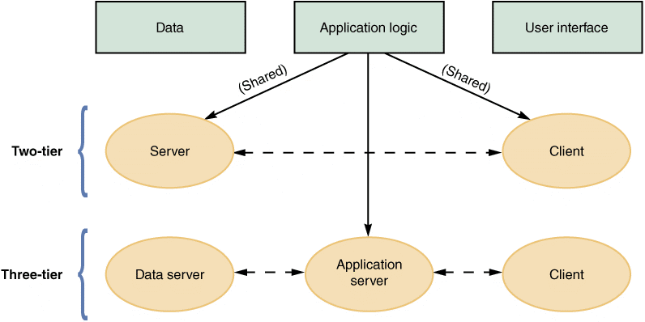
Client/Server Designs (Cont. 4)
FIGURE 10-8 Characteristics of two-tier versus three-tier client/server design.

Slide 18
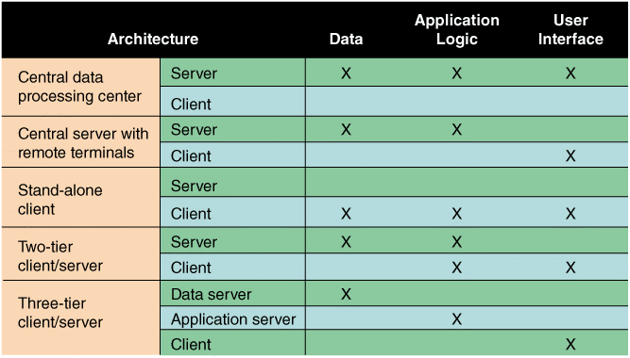
Client/Server Designs (Cont. 5)
FIGURE 10-9 The location of the data, the application logic, and the user interface depend on the type of architecture.

Slide 19
Client/Server Designs (Cont. 6)
Middleware
Enables communication between the tiers
Referred to as glueware
Used to connect two or more software components in a federated system architecture
Integrates legacy systems and Web-based and/or cloud applications
Represents the slash in the term client/server
Cost-Benefit Issues
Client/server systems offer the best combination of features to meet information system requirements

Slide 20
Client/Server Designs (Cont. 7)
Enable firms to scale the system according to the environment
Enable transfer of applications from expensive mainframes to less-expensive client platforms
Reduce workload and improve response times
Performance Issues
Knee of the curve
Response time to requests increases significantly as the system nears its capacity
Client should contact the server only when necessary in a client/server system
Distributed database management system (DDBMS) helps improve client/server performance

Slide 21
The Impact of the Internet
In an Internet-based architecture, the entire user interface is provided by the web server in the form of HTML documents
Shifting the responsibility for the interface from the client to the server simplifies data transmission and results in lower hardware cost and complexity

Slide 22
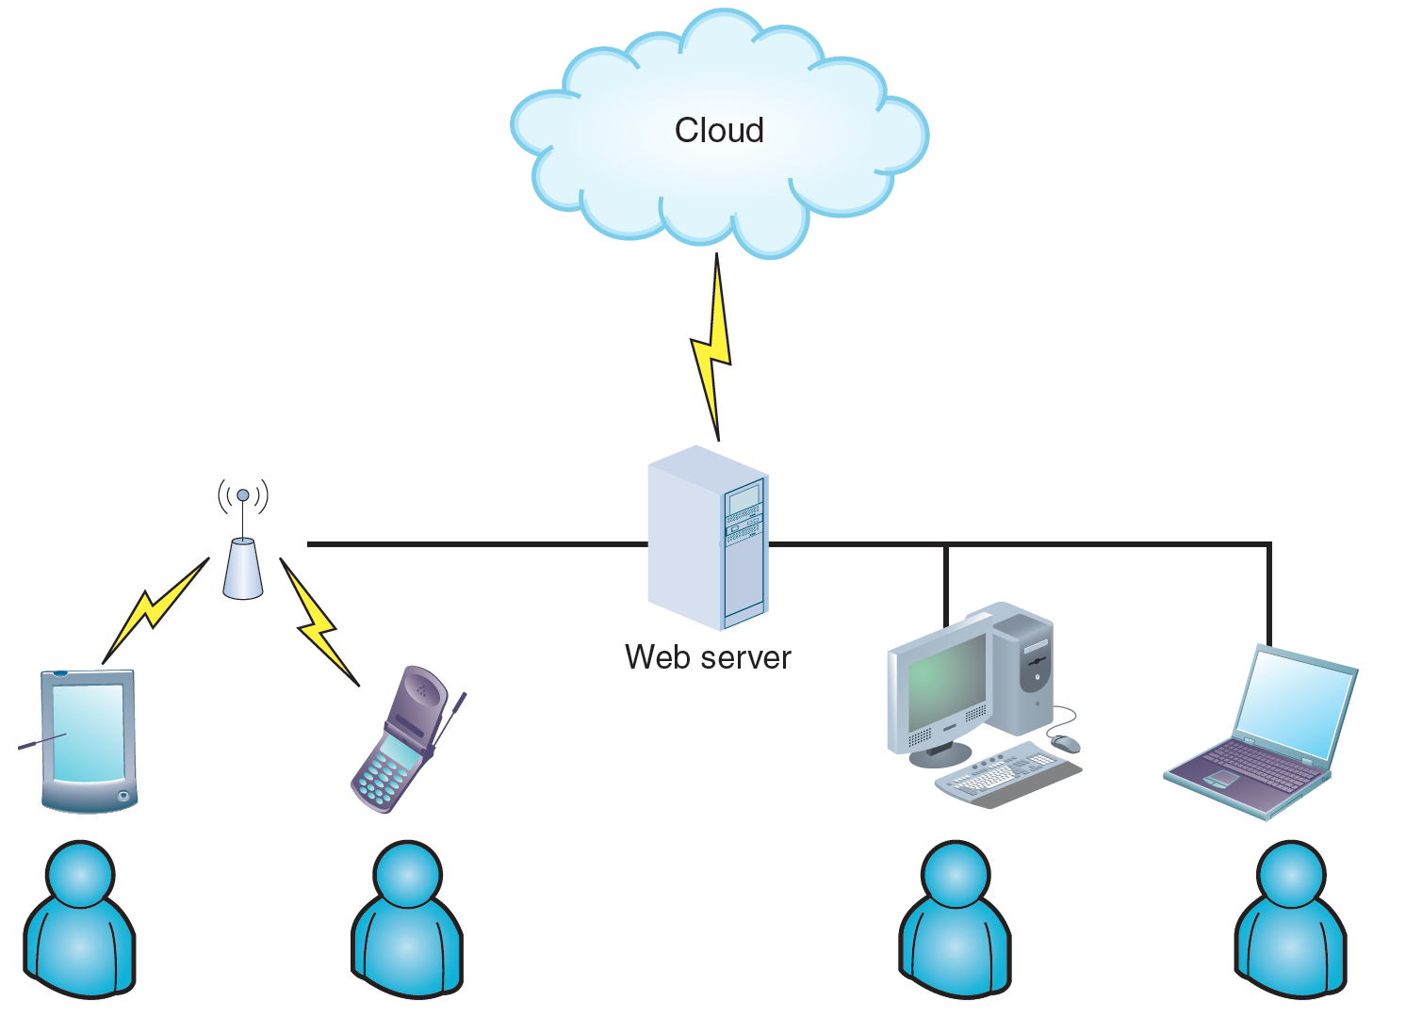
The Impact of the Internet (Cont. 1)
Cloud Computing
The concept envisions a cloud of remote computers providing a total online software and data environment that is hosted by third parties
Eliminates compatibility issues and provides scaling on demand
FIGURE 10-10 Cloud computing

Slide 23
The Impact of the Internet (Cont. 2)
Web 2.0
Second generation of the web
Enables people to collaborate, interact, and share information more dynamically
Considered a step towards the semantic web
Wiki: Web-based repository of information
Run by social collaboration
Users collaborate and add new layers of information to the Internet operating system

Slide 24
Ecommerce Architecture
In-House Solutions
Benefits
A unique website, with a look and feel consistent with the company’s other marketing efforts
Complete control over the organization of the site
A scalable structure to handle increases in sales and product offerings in the future
More flexibility to modify and manage the site
The opportunity to integrate the firm’s web-based business systems with its other information systems

Slide 25
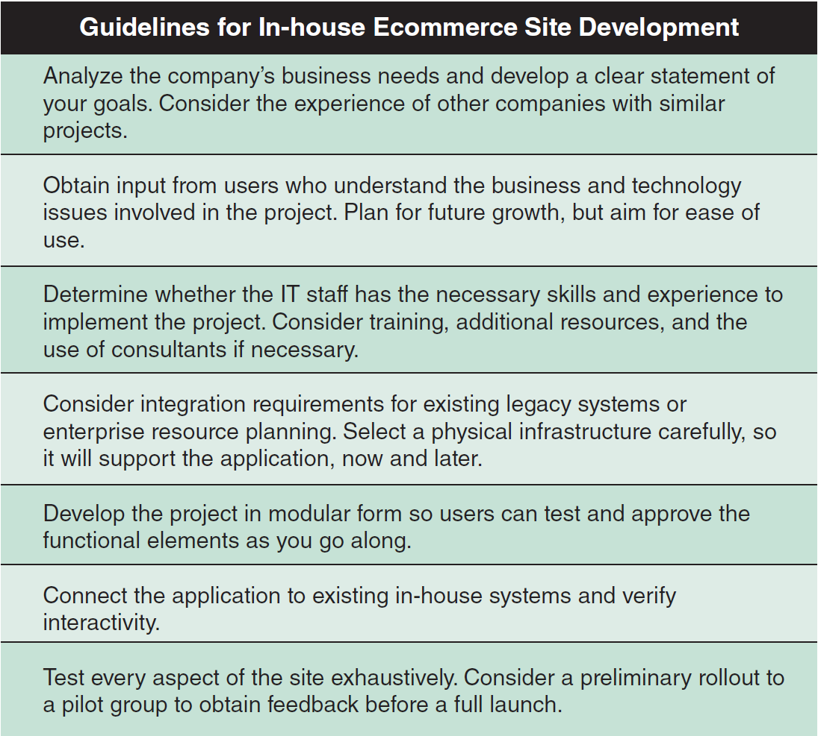
Ecommerce Architecture (Cont. 1)
FIGURE 10-11 Guidelines for companies developing ecommerce strategies.

Slide 26
Ecommerce Architecture (Cont. 2)
Packaged Solutions
Viable alternative for medium- to large-sized firms
Less complex than an in-house effort
Service Providers
Application service provider (ASP) - Provides applications or access to applications by charging a fee
Many ASPs offer full-scale Internet business services for companies that decide to outsource functions

Slide 27
Processing Methods
Online Processing
Online systems handle transactions when and where they occur
Output is provided directly to users
Avoids delays and allows a constant dialog between the user and the system
Can be used with file-oriented systems

Slide 28
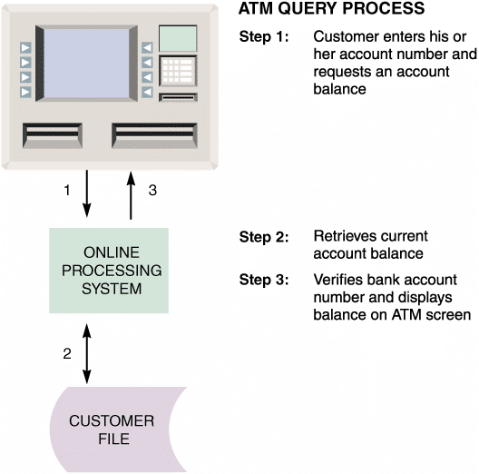
Processing Methods (Cont. 1)
FIGURE 10-13 When a customer requests a balance, the ATM
system verifies the account number, submits the query, retrieves the
current balance, and displays the balance on the ATM screen.

Slide 29
Processing Methods (Cont. 2)
Batch Processing: Still With Us After All These Years
Data is managed in groups
Advantages
Tasks can be planned and run on a predetermined schedule without user involvement
Programs that require major network resources can run when costs and impact on other traffic will be lowest
Well-suited to address security, audit, and privacy concerns

Slide 30
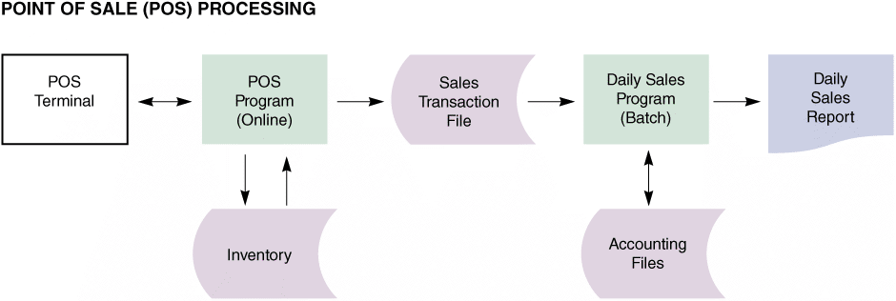
Processing Methods (Cont. 3)
Real-World Examples
Point of Sale (POS) terminals
FIGURE 10-14 Many retailers use a combination of online and batch processing. When a salesperson enters the sale on the POS terminal, the online system retrieves data from the item file, updates the quantity in stock, and produces a sales transaction record. At the end of the day, a batch processing program produces a daily sales report and updates the accounting system.

Slide 31
Network Models
The Open Systems Interconnection (OSI) Model
Describes how data moves from an application on one computer to an application on another networked computer
Provides physical design standards that assure seamless network connectivity, regardless of the specific hardware environment

Slide 32
Network Models (Cont. 1)
Network Topology
Topology - Physical or logical view of the network
Physical topology: Actual network cabling and connections
Logical topology: Describes the way the components interact
Hierarchical network
Departmental servers control lower levels of processing and network devices
Bus network
A single communication path connects the central server, departmental servers, workstations, and peripheral devices

Slide 33

Network Models (Cont. 2)
Ring network
Resembles a circle where the data flows in only one direction from one device to the next
Star network
Has a central networking device called a switch which manages the network and acts as a communications conduit for all network traffic
Mesh network
Each node connects to every other node
Figure 10-15 Although these computers form a physical circle, the physical layout has no bearing on the network topology, which might be a bus, ring, star, or other logical design.

Slide 34
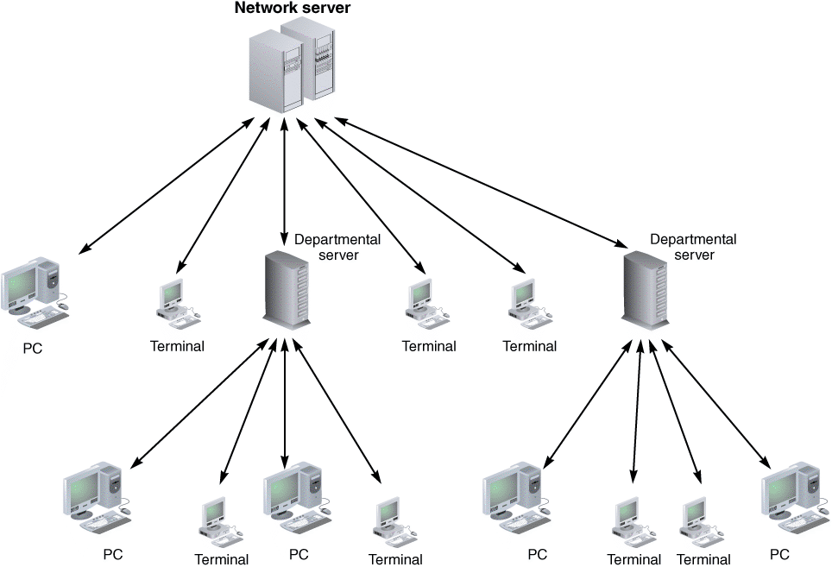
Network Models (Cont. 3)
FIGURE 10-16 A hierarchical network with a single server that controls the network.

Slide 35
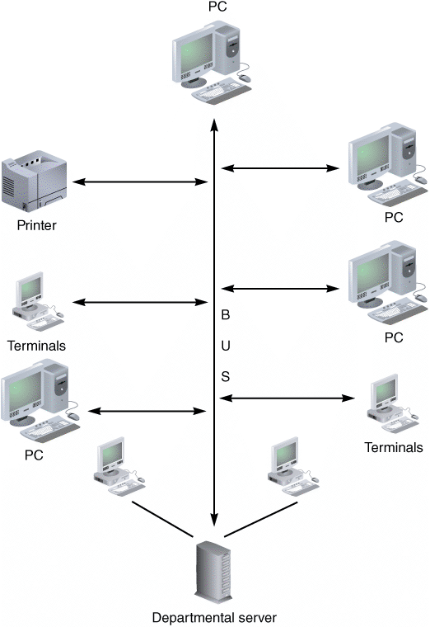
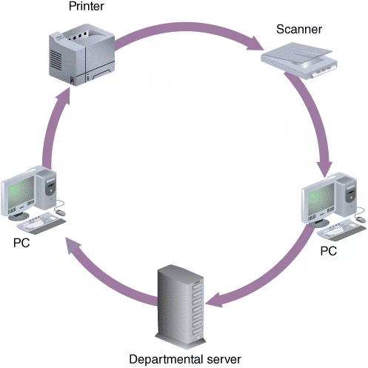
Network Models (Cont. 4)
FIGURE 10-18 A ring network with a set of computers that send and receive data flowing in one direction.
FIGURE 10-17 A bus network with all devices connected to a single communication path.

Slide 36
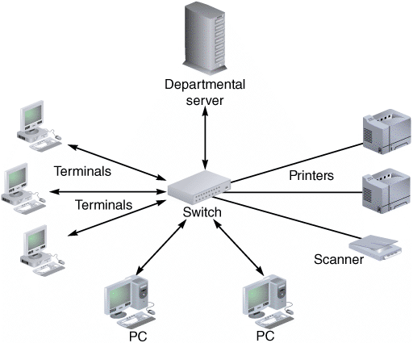
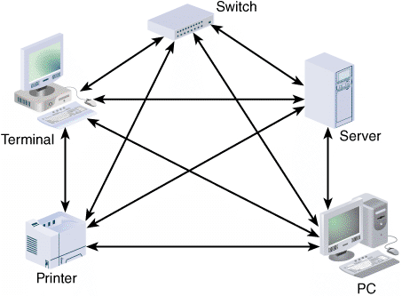
Network Models (Cont. 5)
FIGURE 10-20 A mesh network is used in situations where a high degree of redundancy is needed, such as military applications. The redundant design provides alternate data paths, but is expensive to install and maintain.
FIGURE 10-19 A typical star network with a switch, departmental server, and connected computers, and workstations.

Slide 37
Network Models (Cont. 6)
Network Devices
LANs or WANs can be interconnected using routers
Router: Connects network segments, determines the most efficient data path, and guides the flow of data
Proxy server: Provides Internet connectivity for internal LAN users
Modeling Tools
Microsoft Visio – Used to represent the physical structure and network components of a system
Creatly.com - Offer network diagram drawing capabilities that are completely web-based

Slide 38
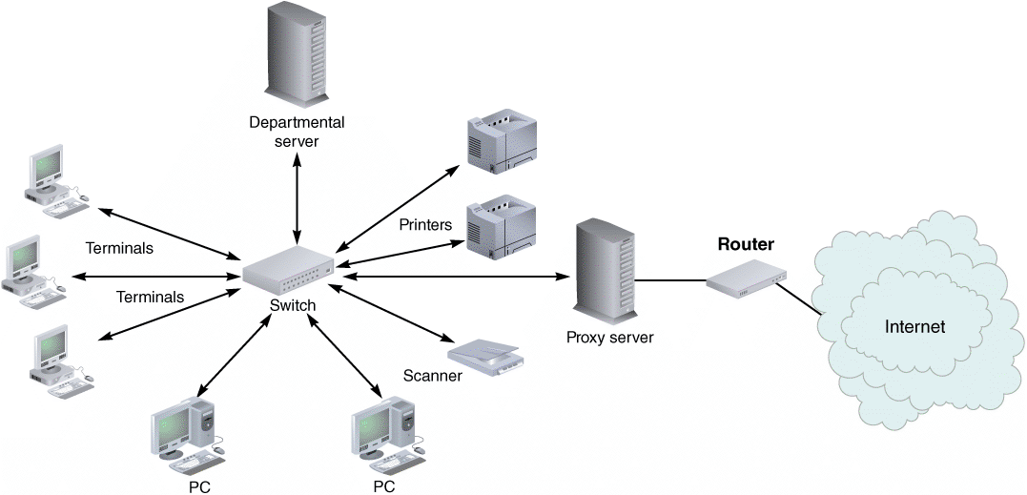
Network Models (Cont. 7)
FIGURE 10-21 Routers can be used to create gateways between different network topologies and large, dissimilar networks such as the Internet.

Slide 39
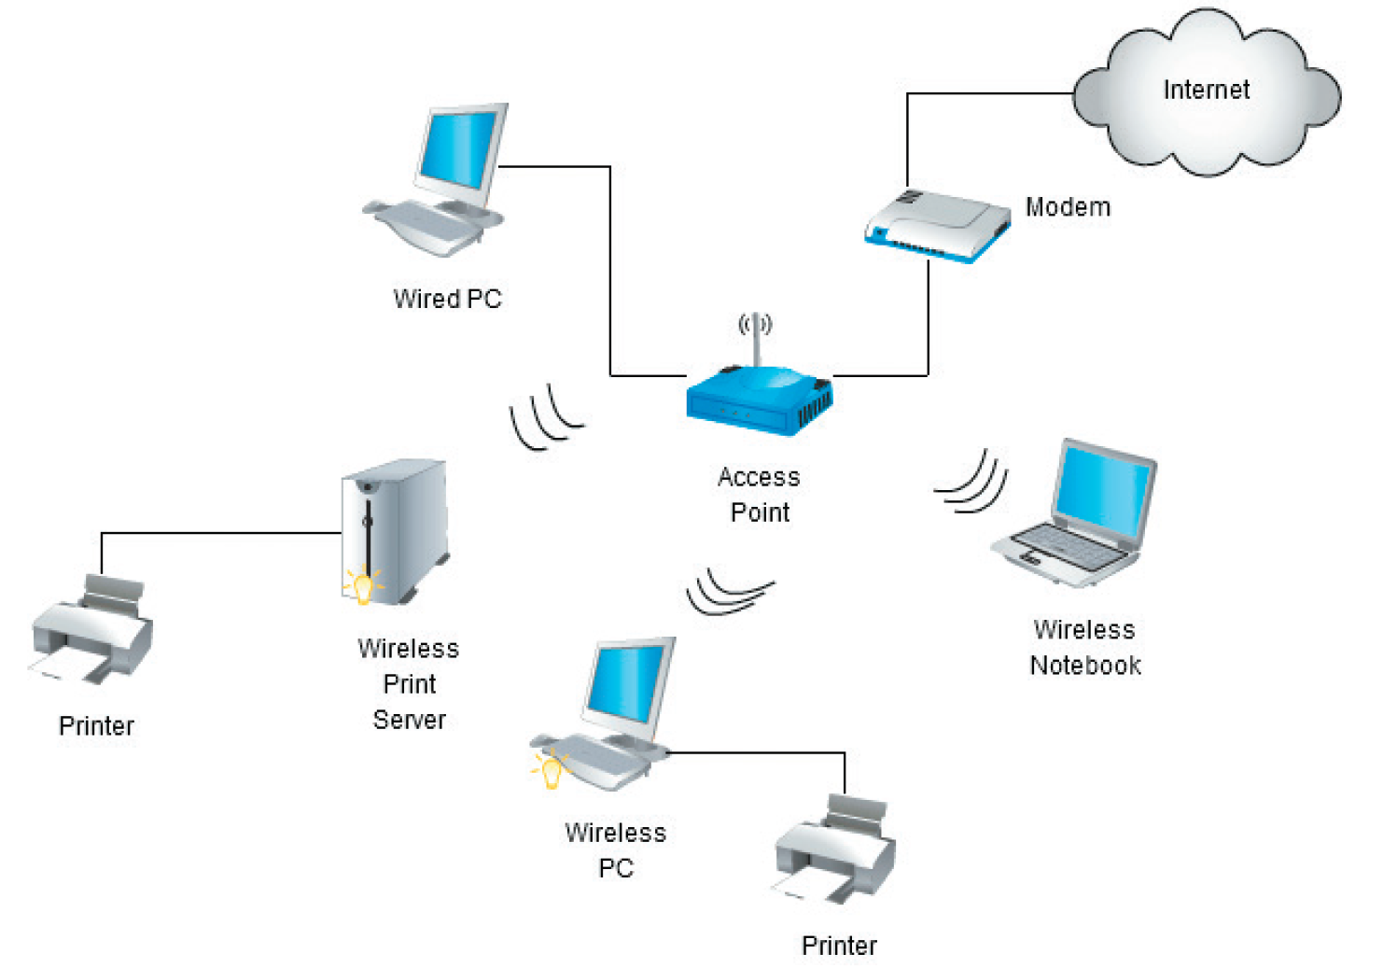
Network Models (Cont. 8)
FIGURE 10-22 Creatly is a web-based software application for creating network diagrams.
Source : © 2008-2015 Cinergix Pty. Ltd.

Slide 40
Wireless Networks
Wireless Network Standards
IEEE 802.11 is a family of standards developed by the Institute of Electrical and Electronics Engineers (IEEE) for wireless LANs
Current wireless networks are based on variations of the original 802.11 standard
802.11g and 802.11n offered increased bandwidth and were widely accepted by the IT industry
Current standards, such as 802.11ac, use multiple input/multiple output (MIMO) technology to boost performance

Slide 41
Wireless Networks (Cont. 1)
Wireless Network Topologies
Network topologies available for IEEE 802.11 WLANs
The Basic Service Set (BSS) or the infrastructure mode
Contains a central wireless device called an access point or wireless access point (WAP) to serve all wireless clients
Extended Service Set (ESS)
Comprises two or more Basic Service Set networks
Wireless access can be expanded over a larger area

Slide 42
Wireless Networks (Cont. 2)
Wireless Trends
Wi-Fi Alliance
A non-profit international association that certifies interoperability of wireless network products based on IEEE 802.11 specifications
Products that meet the requirements are certified as Wi-Fi (wireless fidelity) compatible
Disadvantage - Wireless transmissions are less secure
Bluetooth is used for short-distance wireless communication
IEEE works on 802.16 standards or Wi-MAX
Wi-MAX: Broadband wireless communications protocols for MANs (metropolitan area networks)

Slide 43
System Design Completion
System architecture marks the end of the systems design phase of the SDLC
Final activities in the systems design phase
Preparing a system design specification
Obtaining user approval
Delivering a presentation to management

Slide 44
System Design Completion (Cont. 1)
System Design Specification
Document that presents the complete design for a new information system
Contains detailed costs, staffing, and scheduling for completing the next SDLC phase
Used as a baseline to measure the operational system

Slide 45
System Design Completion (Cont. 2)
Sections in a system design specification
Management summary
System components
System environment
Implementation requirements
Time and cost estimates
Additional material

Slide 46
System Design Completion (Cont. 3)
User Approval
Users must review and approve the interface design, report and menu designs, data entry screens, source documents, and other areas of the system that affect them
Ensures that approvals are obtained as and when required
Keeps the users involved with the system’s development
Provides feedback that can be used to guide efforts
System design specification should be reviewed by other IT department members as well

Slide 47
System Design Completion (Cont. 4)
Presentations
Provide an opportunity to explain the system, answer questions, consider comments, and secure final approval
The first presentation is to the systems analysts, programmers, and technical support staff members who will be involved in future project phases or operational support for the system
Next presentation is to the department managers and users from departments affected by the system
Final presentation is delivered to management
Management will reach a decision based on the presentation

Slide 48
Chapter Summary
An information system combines hardware, software, data, procedures, and people into a system architecture
Before selecting an architecture, the analyst must consider enterprise resource planning, initial cost and TCO, scalability, Web integration, legacy interface requirements, processing options, security issues, and corporate portals

Slide 49
Chapter Summary (Cont. 1)
ERP establishes an enterprise-wide strategy for IT resources and specific standards for data, processing, network, and user interface design
A system architecture requires servers and clients
Client/server architecture divides processing between one or more clients and a central server
A thick client design places all or most of the application processing logic at the client

Slide 50
Chapter Summary (Cont. 2)
A thin client design places all or most of the processing logic at the server
Client/server designs can be two- or three-tier
The Internet has had an enormous impact on system architecture
The most prevalent processing method today is online processing

Slide 51
Chapter Summary (Cont. 3)
Networks allow the sharing of hardware, software, and data resources in order to reduce expenses and provide more capability to users
The way a network is configured is called the network topology
The system design specification presents the complete systems design for an information system and is the basis for the presentations that complete the systems design phase

